Slide 1
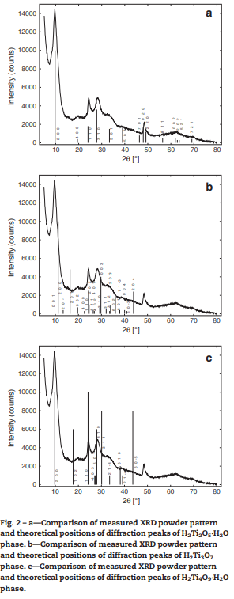

Study of titanate nanotubes by X-ray and electron diffraction and electron microscopy
Objective
The structure of titanate nanotubes prepared by the hydrothermal method was identified to be related to the structure of NaxH2 − xTi2O5·H2O. This was approved by the comparison of powder X-ray diffraction pattern.
Samples
The investigated Ti-NT samples were prepared by hydrothermal treatment of nanocrystalline TiO2 anatase powder. The powder was dispersed in 10 M NaOH aqueous solution. This suspension was put into a closed vessel and heated at 120 °C for 48 h. After the synthesis, the sample was washed and neutralized by HCl. In order to obtain powder samples of Ti-NTs, the sample was freeze-dried.
Procedure
PXRD gives information on the crystalline structure averaged over irradiated volume. On the other hand, HRTEM can be used to visualize the structure of a single nanotube. One of the challenges of this study was to find the required single nanotube. Ti-NTs were ultrasonically dispersed in ethanol and then a drop of the sample was spread on a holey carbon-coated microscope copper grid. Individual nanotubes were studied by HRTEM imaging, performed on JEOL JEM 2100 F FEG (field emission gun) operated at 200 kV accelerating voltage
Conclusion
For improving the agreement of the simulated and experimental X-ray diffraction patterns, it is suggested that the effect of preferred orientation of nanotubes on the substrate holder should be considered

